Slide 1
Grant Geography Workshop
The Graduate School
September 2022
Graduate Pathways Event

Slide 2
Why Apply for Funding?
Speak to an audience outside of your field
Clarify your project
Practice proposal writing skills
Receive funding
Expand your network
Add to your C.V.
Open the door to other opportunities
Work toward becoming an expert

Slide 3
Graduate School Fellowship & Award Opportunities
(Internal)
Summer Research Fellowships
$5,000 to support research activities that advance a doctoral student’s progress toward degree.
Supports students at mid-career
Semester Dissertation Fellowships
$15,000 Dissertation Completion Award
Support students in the latter stages of writing.
Visit Website to view all Graduate School Awards

Slide 4
External Funding Search
Graduate School’s External Fellowship Database
gradschool.umd.edu/funding/fellowships-awards/external-fellowships
University of Illinois Fellowships Finder Database
apps.grad.illinois.edu/fellowship-finder/
GRAPES
grad.ucla.edu/funding/
UMD Libraries - (guides, tutorials, databases)
lib.guides.umd.edu/
Foundation Directory Online (must access through UMD Libraries)
proxy-um.researchport.umd.edu/login?url=http://fconline.foundationcenter.org/ipl.php
SPINPlus Funding Database
spin.infoedglobal.com/Home/Search

Slide 5
Some
Upcoming Deadlines
Institute for Citizens & Scholars Dissertation Fellowships Oct / Nov
Cosmos Scholarship Program - Nov. 1
American Association of Women (AAUW) Fellowships – Nov. 1
Office of Science Graduate Student Research Program (DOE) – Nov 9
Koppitz Child Psychology Graduate Student Fellowship – Nov 15
Kress Foundation – History of Art - Nov. 30
Horowitz Foundation for Social Policy - Dec. 1
Dedalus Foundation Dissertation Fellowship - Dec. 2
Ford Foundation Fellowships - Dec. 8 / Dec 15
Center for Engaged Scholarship (social sciences) - Dec. 15
The Link Foundation (modeling, simulation and training) - Apr. 15
American Council of Learned Societies(ACLS) - various deadlines

Slide 6
Proposal Writing Support and Guidance
Graduate School Writing Center:
gradschool.umd.edu/graduate-school-writing-center
Division of Research Proposal Development and Management Services: (Cara Kennedy ckenned3@umd.edu)
Research.umd.edu/proposal-development-services
Your department and/or your advisor
Workshops like this!
gradschool.umd.edu/funding/workshops

Slide 7


Proposal Development & Management Services

Slide 8
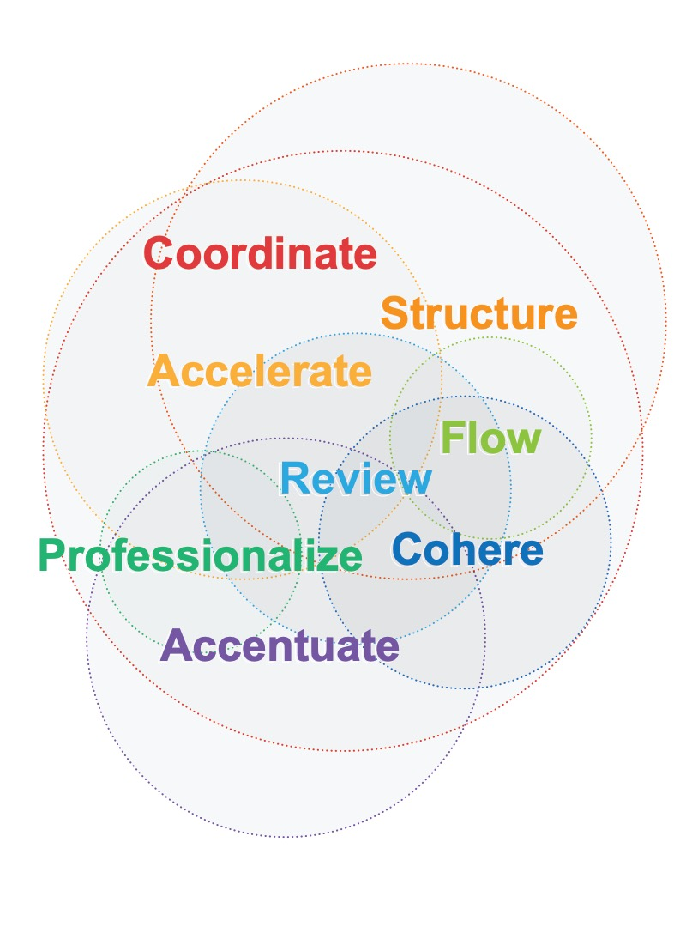
Proposal Development Program Aims
Enhance the quality and competitiveness of proposals while reducing faculty burden.
Adopt industry best practices & professionalize the proposal development process at UMD
Facilitate the scientific and administrative development of complex, visible, and signature research proposals from ideation to submission.

Slide 9
Proposal Development & Management (PDM) Services
For graduate students applying for external awards
Strategize
Develop
Review
Elevate
research.umd.edu/proposals
Notes:
Support at any/multiple levels: Strategize, Develop, Review, Elevate graduate fellowship applications
These services are FREE (supported by Grad School and Division of Research)
PDM services can support external fellowship opportunities that provide grad students with $10,000+ stipends, with or without tuition support.
Draft review
Guidance on framing, strategy, and pitch for competitive national fellowships
Review of written content for responsiveness, clarity, and competitiveness

Slide 10
NIH F31
Workshop Series
AY2022-23
NIH Predoctoral Individual Fellowships Series (F31)
October 6 Are You Ready?: Orientation and planning for an NIH F31
  Who should consider an F31, when in your grad career, how to position yourself
  Testimonials from recent F31 applicants
  Open to all grad students at any level of awareness/readiness
October 20 Writing to Reviewers: Understanding scoring criteria to maximize success
November 3 Telling a Cohesive Story: Bringing your science, training plan, and sponsor statement together
Spring Semester Writing Group targeting April 2023 F31 submissions
Notes:
F31: to enable promising predoctoral students with potential to develop into productive, independent research scientists to obtain mentored research training while conducting dissertation research
All three parts of the Workshop are independent – you can come to one or more, depending on how close you are to submission
Learning Sessions finished by Thanksgiving
*Amanda will get attendee list from today and email when the workshops are announced

Slide 11
PDM
Profiles
Cara Kennedy | Senior Proposal Development Manager
PhD – Clinical Psychology, Arizona State University
Disciplinary Expertise: Behavioral and Social Sciences, Humanities
Unit and Sponsor Specialties: BSOS, CMNS, ENGR, ARHU | NSF, DARPA, USDA-NIFA, Foundations
Gaelle Kolb | PDM
PhD – Biology and Health, University Victor Segalen, Bordeaux, France
Postdoctoral Researcher - NIH / NIAID
Disciplinary Expertise: Biophysics, Neuroscience
Unit and Sponsor Specialties: AGNR, BSOS, COE, ENGR | ARPA-E, Dept of Ed, NSF, NIH
Michelle Smith | PDM
BA – Neuroscience, Johns Hopkins University
Certified Clinical Research Professional
Disciplinary Expertise: Neuroscience, Public Health, Neurology, Medicine
Unit and Sponsor Specialties: SPH, BSOS, CMNS | CDC, NIH, NSF
Amanda Dykema | PDM
PhD – English, University of Maryland
Disciplinary Expertise: Humanities, Arts, Social Sciences
Unit and Sponsor Specialties: ARHU, BSOS, CMNS, COE | NSF, NEH, Foundations

Slide 12
Getting Started
To learn more:
PDM Services Page
To register for F31 seminar:
https://forms.gle/v2XSoyv93wnmndDp6
To find opportunities:
UMD External Fellowships Database
University of Illinois Fellowships Finder
To talk with with one of our team:
Questions? Email us at proposals@umd.edu

Slide 13
Student Feedback
https://www.youtube.com/watch?v=QZnmWDCU0Ek

Slide 14
If you receive a Full-Time Prestigious External Fellowship...
You can request tuition remission from the Graduate School
You can request reimbursement for the purchase of the Student Health Insurance plan (currently $2334 per year)
Go to forms website

Slide 15
Writing the Fellowship Application
Linda Macri, PhD
lmacri@umd.edu

Slide 16
Writing Your Application
Rhetorical Situation = the situation that shapes the argument and the potential of the argument
What’s in that situation?
  Speaker/author
  Audience
  Issue or topic
  Goal or purpose
  Constraints (word limit, medium, genre, etc.)
  The particular moment (exigence and context
Notes:
What are you trying to persuade this audience to do – give you the grant – and they’ll do that because you persuaded them that . . .

Slide 17
Writing Your Application:
Author
Know what you are talking about
How does your project fit the goals of this funding organization?

Slide 18
Writing Your Application:
Goal
What is the goal of this document?
What do you need to achieve that goal?
Notes:
What are you trying to persuade this audience to do – give you the grant – and they’ll do that because you persuaded them that . . .

Slide 19
Writing Your Application:
Audience
Know who you are talking to
  What do they say about their values and priorities?
  How does that translate into what they want to fund?
Know what they want
  In general, your audience wants to know how you will help the program meet its goals.

Slide 20
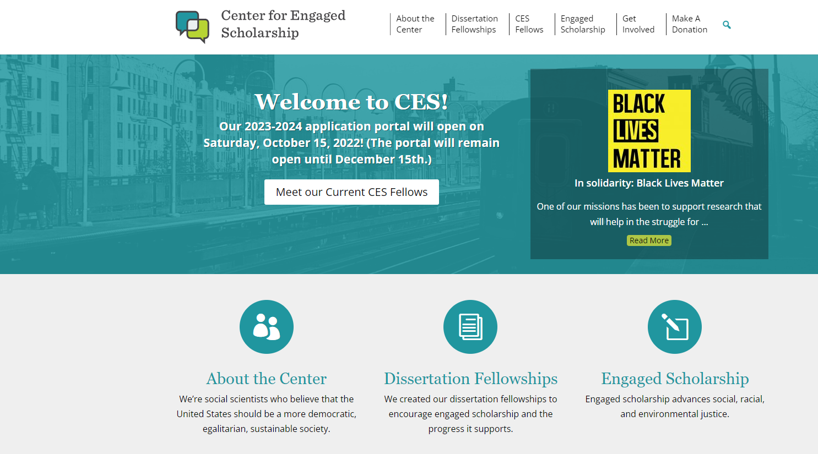
An example:
Center for Engaged Scholarship
cescholar.org/

Slide 21
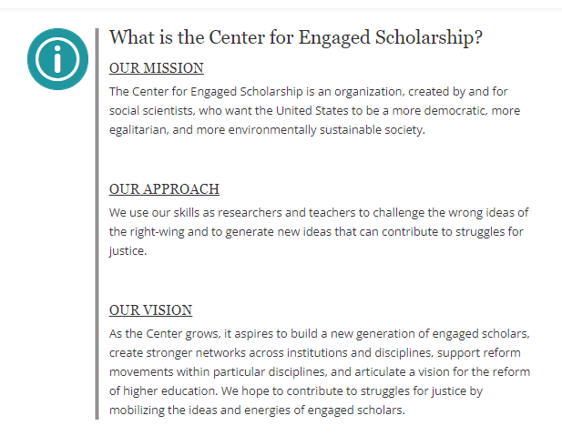
An example:
Center for Engaged Scholarship
cescholar.org/

Slide 22
Writing Your Application:
Audience
For many external grant applications, the reviewers are not (or not only) in your discipline. How will you communicate the importance of your research to them?

Slide 23
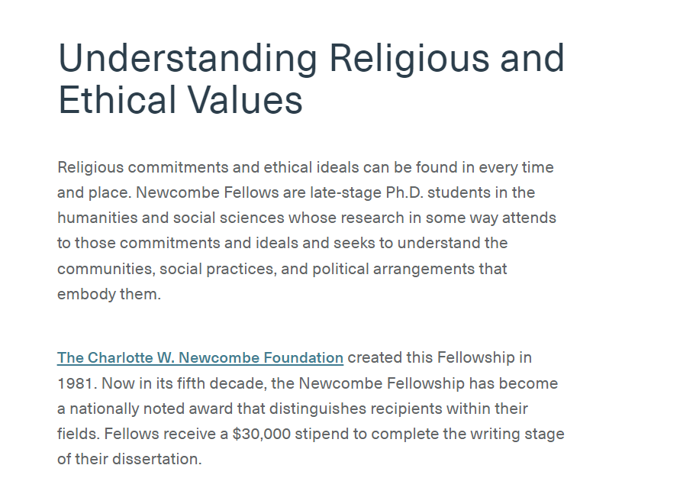
An example:
Charlotte W. Newcombe Dissertation Fellowship
https://citizensandscholars.org/fellowships/for-scholars-education-leaders/charlotte-w-newcombe-fellowship/

Slide 24
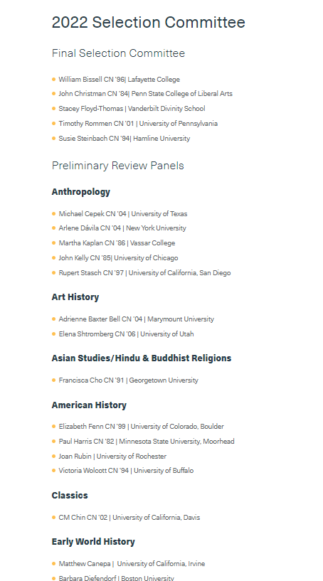
An example:
Charlotte W. Newcombe Dissertation Fellowship
https://citizensandscholars.org/fellowships/for-scholars-education-leaders/charlotte-w-newcombe-fellowship/newcombe-selection-committee/

Slide 25
Writing Your Application:
Audience
An audience beyond your discipline likely needs more 0r different context than a disciplinary audience will.
  What context might you add? Why does your research matter in that context?
An audience beyond your discipline may need more explanation than a disciplinary audience.
  What do you need to explain? Why does it need explanation?

Slide 26
Writing Your Application:
Audience
Reviewers want to know:
What will be learned as a result of your project (goals/outcomes)
Why is what you are seeking to learn worth knowing? (significance—so what?)
How will you know that your conclusions are valid? (criteria for success)
What will the greater impact of your work be?

Slide 27
Writing Your Application:
Topic
what do you plan to do?
what will result (you hope)?
how it will advance the field / improve the world (impact)?

Slide 28
Writing Your Application
Constraints
Respond to the specifics of the application
  Project description, proposal, timeline, personal statement
  Follow page limits, etc.
This is and isn’t “academic writing”
  Tell a research story – what background do readers need, what is unfolding, what’s the triumphant conclusion

Slide 29
An example:
Cosmos Club Foundation www.cosmosclubfoundation.org/scholars/
GUIDELINES
The major criterion for selection is the excellence of the research proposal. No specific format or organization is required, but applicants should state clearly what work is proposed, how and when it would be performed, and why the results would be important or useful. Our preference is for topics not anticipated when the overall research program was proposed and therefore not covered by support originally planned.
It is essential to make the project description understandable to scholars in other fields, while retaining enough detail to satisfy a specialist in the field of the proposal.

Slide 30
Ala Creciun – History -- Application for Cosmos
Reform on the Eve of Revolution: Russian Press and Competing Visions for the Monarchy in the 1880s
Exigence
This year’s centennial of the 1917 Revolution has prompted a tide of new and stimulating works revisiting its dramatic course, but Nicholas II (1894-1917) was not the first Russian tsar to die at the hands of revolutionaries. In 1881, his grandfather, Alexander II (1855-1881), was publicly and brutally assassinated by revolutionary terrorists, unravelling a veritable crisis of monarchic rule. The period that followed, the rule of Alexander III (1881-1894), remains considerably understudied. The few traditional accounts portray it as a relatively uneventful time of repression and decline that led to the Revolution. But, more recently, economic historians have pointed to vibrant economic development and industrial growth during the 1880s and 1890s, challenging this decline paradigm. Still, little has been done to explain the transition from crisis to progress in such a short period of time. As a result, this pivotal period of change on the eve of Revolution remains poorly understood.
The story so we thought
A new story unfolds
Notes:
Opening paragraph
-- how is she creating exigence
How do we see a story being told

Slide 31
Mary DePascale –HDQM (College of Ed)
Cosmos Application 2020
Promoting Children’s Early Mathematical and Statistical Understanding through Parent-Child Math Games
Basic statistical literacy is essential for understanding and making inferences from information received from external sources and for developing critical thinking skills necessary for engagement in real-world contexts. These skills are essential throughout the lifespan, as adults constantly consider data and sources when making decisions, such as what to buy, where to live, and how to vote. The foundation for these skills is built in early childhood, as data analysis is a central topic area in children’s early mathematical development (National Council of Teachers of Mathematics, 2000). Therefore, developing engaging, effective methods for teaching early data analysis is important, as they have the potential to enhance children’s development of statistical understanding, overall math abilities, and higher order thinking skills. My dissertation research extends prior work on the role of games as an engaging method for math learning in early childhood, by focusing specifically on promoting children’s early statistical through a home-based graphing game intervention.
Context
Why this matters
What I’m doing

Slide 32
As you draft…
Look at your draft/description
Check for audience—who is going to read it? Is it written for them?
Check for “so what”– why will the audience care? When do you make them care?
Check for story– is there a logical unfolding, a narrative line to follow?

Slide 33
Upcoming
Workshops
Applying for the Ford Foundation Fellowships
  Sept. 28 & 29; Oct. 19; Nov. 8
Applying for Graduate School Fellowships
  Dec 6 & 7 & 13
Drop in hours at the Graduate School Writing Center
  Wednesdays, 12-3pm via zoom

Slide 34

Thank you!
Robyn Kotzker
Program Manager,
Office of Funding Opportunities
rkotzker@umd.edu
301-405-0281
Linda Macri
Director
Graduate School Writing Center
lmacri@umd.edu
301-405-7882

