Slide 1
AN 80,000 WORD THESIS
WOULD TAKE 9 HOURS TO PRESENT.
YOUR TIME LIMIT.... 3 MINUTES!
UMD THREE-MINUTE THESIS COMPETITION
Register to compete by February 21, 2022
Register HERE
The Three Minute Thesis (3MT®) is an academic competition developed by
The University of Queensland (UQ), Australia for research students.

Slide 2
What is 3MT?
The University of Queensland (UQ) 3MT competition cultivates students’ academic, presentation, and research communication skills. Preparing a 3MT presentation increases their capacity to effectively explain their research in three minutes, in a language appropriate to a non-specialist audience.

Slide 3
History of the 3MT
The idea for the Three Minute Thesis (3MT®) competition came about at a time when the state of Queensland was suffering severe drought. To conserve water, residents were encouraged to time their showers, and many people had a three minute egg timer fixed to the wall in their bathroom. The Dean of the UQ Graduate School put two and two together and the idea for the 3MT competition was born.
2008 – 3MT developed by the University of Queensland (UQ)
2013 – Universitas 21 held their first 3MT International Competition
2014 – UMD entered the Universitas 21 International Competition
Today – hundreds of Universities and Associations worldwide hold 3MT competitions
UMD SUCCESS in U21 Competitions
2014 – Amy Marquardt, Materials Science and Engineering (First Prize & People’s Choice)
2015 – Carly Muletz Wolz, Biological Sciences (People’s Choice)
2017 – Sammy Ramsey, Entomology (First Prize & People’s Choice)

Slide 4
University of Maryland
3MT Competition
First-Round College-Level
5 college-level competitions:
CMNS
ENGR
ARHU-BSOS
AGNR-BMGT-PLCY-SPHL
ARCH-EDUC-INFO-JOUR
College-level competitions occur in early March
Each college-level competition can advance up to 4 students to compete as Semi-Finalists in the Final-Round.
College-Level prizes will be determined at the college level.
Final-Round Campus-Level
Up to 20 Semi-Finalists will compete in the Final Round.
Final round will be held on April 6, 2022.
An interdisciplinary panel will name up to six Campus-Level winners.
Campus-level winners will receive a $1000 prize and professional production of their 3MT presentation.
UMD Competition is open to master’s, pre-candidacy, and post-candidacy students
Register to compete HERE by February 21, 2022
Full Details: gradschool.umd.edu/funding/student-fellowships-awards/umd-three-minute-thesis-competition

Slide 5
3MT Rules
https://threeminutethesis.uq.edu.au/virtual-competition-rules
A single static PowerPoint slide
No additional electronic media (e.g. sound and video files)
No additional props (e.g. costumes, musical instruments, laboratory equipment)
No edits
Presentations are limited to 3 minutes
Presentations are to be spoken word (e.g. no poems, raps or songs).

Slide 6
3MT Judging Criteria
https://threeminutethesis.uq.edu.au/resources/judging-criteria
Provide some background and explain significance
Present to a non-specialist audience and follow a clear and logical sequence
Describe the key results, if applicable
Convey enthusiasm for research and make the audience want to know more!
Have stage presence!

Slide 7
Resources available to students
3MT Workshops
Graduate School Writing Center: Make an appointment with Dr. Linda Macri or a Writing Fellow at the Graduate School Writing Center for brainstorming, feedback, and guidance on your 3MT.
One Button Studios: Use one of the One Button Studios located across campus to help make a 3MT recording.

Slide 8
Important Dates for 3MT
February 21: Deadline to register to compete
March 1: For virtual competitions, your 3MT Video and slide are due
Mar 2 - 18: College-Level First-Round Competitions (virtual, hybrid, and/or in-person).
Mar 19 - Apr 5: Semi-finalists prepare for the Final-Round
April 6: Final-Round Competition (during GRAD)

Slide 9
Three-Minute Thesis Workshop
Linda C. Macri, Ph.D.
Director
Graduate School Writing Center
Fall 2021
Notes:
Introduction to the competition but also to the idea of delivering your research in a succinct, accessible way –
The contest got its start in Australia in 2008, and three years later the University of British Columbia became the first North American university to adopt the concept. The competition has caught on across Canada: dozens of universities held 3MT contests this spring. Ontario and Quebec have come up with the idea of provincials, and in the next year or so there could well be nationals.
From AAS: This scientific version of the elevator pitch is intended to celebrate doctoral research, hone participants’ communication skills, and disseminate research to the public.
The idea is NOT to simplify your ideas, but to flex your communication muscles – you should be able to talk about your research in a sentence, in three minutes, in an introduction, in an article, in 300 pages – so, this afternoon, we’ll talk a bit about ways to do that – I’ll talk specifically about the 3MT competition at Maryland, but, more broadly, about ways to make your research engaging and accessible to an interndisciplinary audience – like you have to at Thanksgiving, and like you’ll have to at a job interview –
Today we are going to focus on introducing the idea and getting some general understading of this GENRE – we won’t focus on the visuals and we won’t focus very much on the presentation – but those are two really important elements of ANY presentation – so if you think you would be interested in those as well, let me know – there will be an evaluation for you to let us know
We are joined today by two people who have done very different version of these videos – and I am very grateful that they are here to help us start to dive into understanding this way of communicating your research
So let me introduce Sammy Ramsey,, a doctoral candidate in Entomology and last year’s Maryland 3MT winner – he also went on to win the U21 competition – and that’s all I’ll say about him because You are going to hear about his research from him, – and let me also introduce Prof. Jason Farman, Director of the Design Cultures & Creativity Program, an Associate Professor in the Department of American Studies, and a faculty member with the Human-Computer Interaction Lab at the University of Maryland, College Park – and again, that’s all I’ll say abou this research because you’ll hear more about it from him in a minute –We are going to watch Carly’s winning 3MT video and a video focusing on Jason’s research and recent book, part of a series from ARHU promoting the work of humanities faculty – as you watch, I’m going to ask that you pay attention to what each aims to do how they do it, what they might have in common, what’s effective

Slide 10
Sammy Ramsey, Entomology

Slide 11
The Rhetorical Situation
Rhetorical Situation = the situation that shapes the argument and the potential of the argument
What’s in that situation?
Audience
Speaker/author
Purpose
Constraints (word limit, medium, etc.)
The particular moment/exigence

Slide 12
Audience
For 3MT – knowledgeable, academic, cross-disciplinary
So what does that mean about how to talk to them?

Slide 13
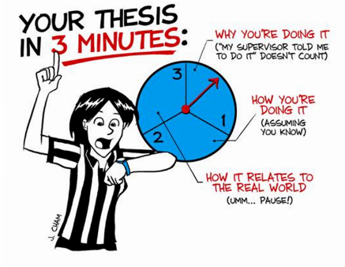
Constraints
Notes:
The biggest constraint is TIME -- in the details, it also has to be one take, not read, etc.

Slide 14
Constraints
One slide, no animation
3 minutes
One take

Slide 15
Purpose
What is your purpose in these three minutes?
Explain?
Persuade?
Make them remember – pique their curiosity.

Slide 16
Simple Rules for Success
Change the world
Make me care
Be passionate

Slide 17
Simple Rules for Success
Change the world
Start with the big picture, a broad context
Help your audience see that there is a problem (even if the problem isn’t at the top of their list) (create exigence)
THEN explain how you are contributing to a solution

Slide 18
Simple Rules for Success
Make me care
The audience needs to relate to the issue in order to follow the delivery
Your audience has a broad capacity for caring—but you have to help develop it
Notes:
Think about this – within your discipline, this “caring” is covered because you share interests, etc. Here, in an audience beyond your discipline, you need to create that sense of interest, concern, caring

Slide 19
Amy Marquardt, Material Science Engineering, 2014 Winner

Slide 20
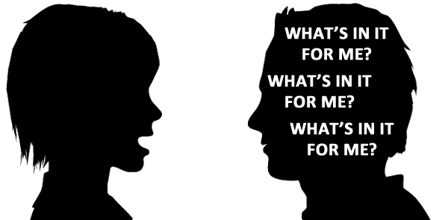

Slide 21
Simple Rules for Success
Be passionate
If you aren’t excited, why should I be?
Notes:
But all of this seems like it means that there are ideas out there that are better suited – climate change, medical breakthroughs, etc. – yes, but no --

Slide 22
Carly Muletz Wolz, Biology
Notes:
Introduce Carly – name, department, I won’t introduce her research because you’ll see that -- you probably don’t care much about salamanders – but it’s clear that she does, a lot

Slide 23
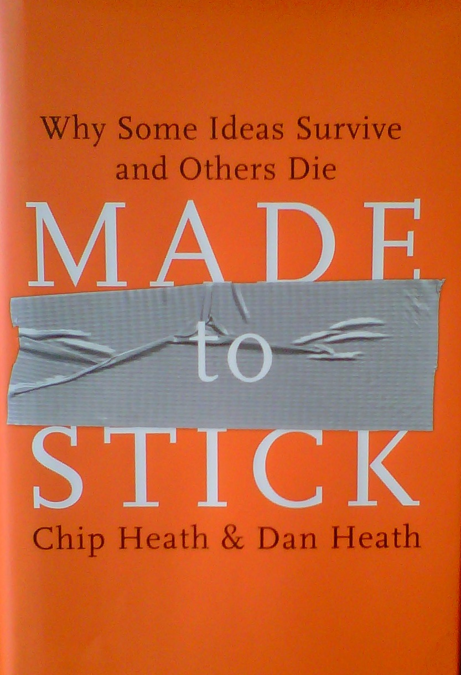
“It’s the nature versus nurture debate applied to ideas: Are ideas born interesting or made interesting?” (5)
Notes:
Simple – but not simplistic or dumbed down
Unexpected
Concrete
Credible
Emotional – not the same as manipulative
Stories – we follow narratives for a reason

Slide 24
Center for Science in the Public Interest & movie popcorn
A medium sized movie popcorn contains 37 grams of saturated fat, twice the recommended daily amount of saturated fat.
Notes:
Simple – but not simplistic or dumbed down
Unexpected
Concrete
Credible
Emotional – not the same as manipulative
Stories – we follow narratives for a reason

Slide 25
Center for Science in the Public Interest & movie popcorn
“A medium-sized ‘butter’ popcorn at a typical neighborhood movie theater contains more artery-clogging fat than a bacon-and-eggs breakfast, a Big Mac and fries for lunch, and a steak dinner with all the trimmings—combined!”
Notes:
Simple – but not simplistic or dumbed down
Unexpected
Concrete
Credible
Emotional – not the same as manipulative
Stories – we follow narratives for a reason

Slide 26
Made to Stick
Simple
Unexpected
Concrete
Credible
Emotional
Stories
Notes:
Simple – but not simplistic or dumbed down
Unexpected
Concrete
Credible
Emotional – not the same as manipulative
Stories – we follow narratives for a reason

Slide 27
Simple
Not simplistic, not dumbed down. But the CORE of your idea.
Limited, focused
Often, you have to know the complex idea to make it simple (but not to make it dumb).

Slide 28
Complex v. Simple
Published Research
3MT
Notes:
I found that the ceramic ALD films lasted
02:07
about 15 times longer than the plastic coatings.
02:11
That's a huge improvement.

Slide 29
Complex v. Simple
Our recent work demonstrates that ALD films are a promising technique to prevent damage from the corrosion process, and subsequent polishing, for silver cultural heritage objects. Our previous results find that 20 nm Al2O3 ALD films protect silver from tarnishing nearly 15 times longer than microns-thick nitrocellulose films: this amounts to a potential ambient effective film lifetime of 150 years.
I found that the ceramic ALD films lasted about 15 times longer than the plastic coatings.
2:07-2:11

Slide 30
Complex v. Simple
Published Research
3MT
Ramsey, S. D., Ochoa, R., Bauchan, G., Gulbronson, C., Mowery, J. D., Cohen, A., ... & Hawthorne, D. (2019). Varroa destructor feeds primarily on honey bee fat body tissue and not hemolymph. Proceedings of the National Academy of Sciences, 116(5), 1792-1801.

Slide 31
Complex v. Simple
Moreover, determination of the primary source of nutrition for Varroa would change our understanding of the etiology of this parasite and could potentially lead to the development of novel—and of active interest—more effective treatment strategies (e.g., systemic pesticide formulations, interfering RNA, and so forth). To that aim, we conducted a three-tiered study asking the following questions: (i) Do so called phoretic Varroa feed primarily or exclusively in proximity to the fat body?
“ . . .the goal was to figure out what varroa is eating. I started with the question where do they feed? If they can feed anywhere on a bee, the way that a tick can on you, then they're probably feeding on blood. However, if they feed only in one spot maybe they're eating a tissue specific to that location.

Slide 32
Complex v. Simple
Moreover, determination of the primary source of nutrition for Varroa would change our understanding of the etiology of this parasite and could potentially lead to the development of novel—and of active interest—more effective treatment strategies (e.g., systemic pesticide formulations, interfering RNA, and so forth). To that aim, we conducted a three-tiered study asking the following questions: (i) Do so called phoretic Varroa feed primarily or exclusively in proximity to the fat body?
“ . . .the goal was to figure out what varroa is eating. I started with the question where do they feed? If they can feed anywhere on a bee, the way that a tick can on you, then they're probably feeding on blood. However, if they feed only in one spot maybe they're eating a tissue specific to that location.

Slide 33
The Unexpected
“Instead of sucking out your blood, it’s liquefying one of your internal organs.”
“We are covered with microbes”

Slide 34
The Unexpected
There’s probably something so familiar to you that you have forgotten it’s interesting
Tell a neighbor the most interesting thing about your research

Slide 35
Abstract/Concrete
What in your work is abstract? Should it and could it be more concrete?
What in your work is very concrete, specific, maybe even applicable in only one situation? Can you discuss it it more abstract, or broadly applicable, terms?

Slide 36
Abstract/Concrete
Effective speakers “climb up and down the ladder of abstraction”
Roy Peter Clark Writing Tools: 50 Essential Strategies for Every Writer.
Notes:
http://sixminutes.dlugan.com/ladder-abstraction/

Slide 37
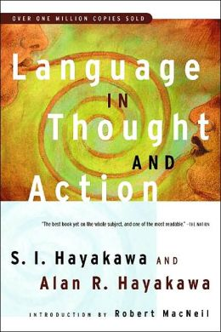
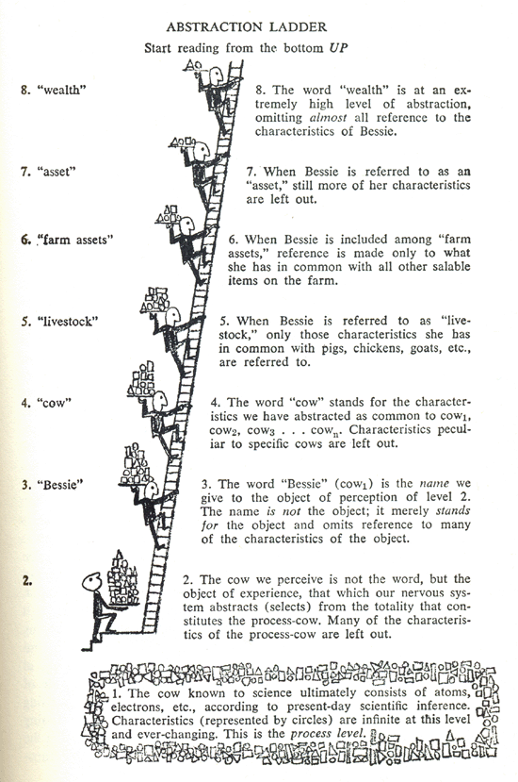

Slide 38
WEALTH
LIVESTOCK
BESSIE, MY COW

Slide 39
Making concepts more concrete
Sequencing an explanation
Explaining how a phenomenon occurs/occurred
How did it start?
What happens/happened next?
And what happens/happened after that/what results?
Explaining HOW something works
What is it used for?
What does each part do?
How do parts work together?

Slide 40
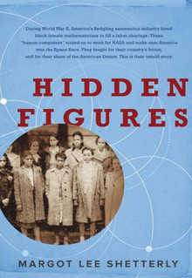
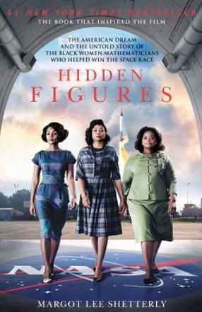
METAPHORS make ideas more concrete
Explaining the aerospace research that took place at NACA during World War II, before NASA existed.
Long before a plane was sent into production, it was tested at NACA for “drag cleanup.”
The concern was about uneven wing geometry.
Explain why that would be a problem? You’ve all flown. . . .
“Did the plane roll unexpectedly? Did it stall? Was it hard to maneuver, resisting the pilot like a shopping cart with a bad wheel.”

Slide 41
Emotional
Emotions ≠ tears
Pathos – appeal to the concerns of the audience
Why should your audience CARE
Notes:
http://sixminutes.dlugan.com/ladder-abstraction/

Slide 42
Stories
Characters/actors (not necessarily human)
Challenges/a quest
Some kind of tension about whether the characters will succeed or fail in the challenges
A beginning, middle, end
Notes:
We are storytelling animals; we like things with a narrative, we don’t just like them, we remember stories better. But how do you tell a story about . . . .your research? What elements do stories have -- all these tell us WHAT’s THE POINT

Slide 43
The Slide
Persuade with the image: what do you need to explain that your words can’t fully convey
Illustrate
Explain a process
Offer data – graphic representation of results
Offer analysis or causality
Tie things together
But not all of that!

Slide 44
Spoken v. Written Prose
You are speaking these presentations. So to compose, don’t just write them, but speak them.
Notes:
How to write these – one answer is don’t write them – speak them. Because there are differences between how we write and how we speak, and these are definitely spoken, not read, then it makes sense to speak them in your invention stage – not write them – so use the memo recorder on your phone, talk them out to people

Slide 45
Using Questions
You may have been told not to use questions in academic writing
Informal | Formal Alternatives
What do we mean by “stalking”? It has been defined as “a long-term commitment to engaging in persistent campaigns of harassment that have …” | McEwan et al. define stalking as “a long-term commitment to engaging in persistent campaigns of harassment that have the potential to cause immense …”
http://nool.apa.uoit.ca/portfolio/formal-academic-writing/

Slide 46
Using Questions
But this isn’t academic writing.
Questions engage
Do you remember the answer to this: “But why care about woodland salamanders and their microbes?”
Were you compelled to wonder about the answer?

Slide 47
Words
What are the key words that your audience really needs to know?
1000 most common words
Words to use, words to explain
Connecting to the known and familiar
Metaphors/analogies, stories, “known-new”

Slide 48
Known-New
Readers expect to get familiar information first then new information.
That’s an expectation, not a rule.
Known-new contract

Slide 49
I started with the question where do they feed.
If they can feed anywhere on a bee, the way that a tick can on you, then they're probably feeding on blood. However if they feed only in one spot, maybe they're eating a tissue specific to that location. The results? They feed only in one spot, on the underside of the bees abdomen. The tissue in this area is called the fat body and this is significant because the fat body doesn't just store nutrients it detoxifies pesticides regulates hormone levels it produces the honeybee’s primary immune response to microbial invaders and that's just four of its nine functions.

Slide 50
I started with the question where do they feed.
If they can feed anywhere on a bee, the way that a tick can on you, then they're probably feeding on blood. However if they feed only in one spot, maybe they're eating a tissue specific to that location. The results? They feed only in one spot, on the underside of the bees abdomen. The tissue in this area is called the fat body and this is significant because the fat body doesn't just store nutrients. It detoxifies pesticides regulates hormone levels it produces the honeybee’s primary immune response to microbial invaders and that's just four of its nine functions.

Slide 51
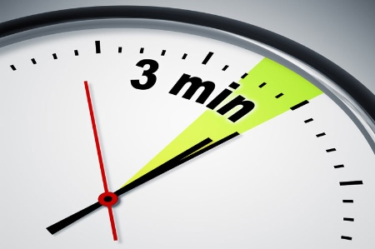
Questions?

